Slide 1

Model Evaluation Measure
USA | Singapore
©DeepSphereAI.SG 2021 | Confidential & Proprietary

Slide 2
Mean Squared Error
Mean Squared Error (MSE) is defined as the Mean or Average of the square of the difference between actual and estimated values ( predicted value or the forecasted value, or this is the output of your regression model).
MSE is used to check how close estimates or forecasts are to actual values. The lower the MSE, the closer the forecast is to the actual. This is used as a model evaluation measure for regression models, and the lower value indicates a better fit.
USA | Singapore
©DeepSphereAI.SG 2021 | Confidential & Proprietary

Slide 3
Mean Squared Error
Variance = Difference =Error
Squared Error
Model Pediction
Month
Actual
Forecast
1 | 42 | 44 | -2 | 4
2 | 45 | 46 | -1 | 1
3 | 49 | 48 | 1 | 1
4 | 55 | 50 | 5 | 25
5 | 57 | 55 | 2 | 4
6 | 60 | 60 | 0 | 0
7 | 62 | 64 | -2 | 4
8 | 58 | 60 | -2 | 4
9 | 54 | 53 | 1 | 1
10 | 50 | 48 | 2 | 4
11 | 44 | 42 | 2 | 4
12 | 40 | 38 | 2 | 4
Sum |  |  |  | 56
Mean Squared Error
MSE= 56/12 = 4.6667

Slide 4
Mean Squared Error: Practice Exercise
Through Python Programming, calculate the following
MSE (Mean Squared Error)
RSME (Root Mean Squared Error)
MAE (Mean Absolute Error)
R2 ( R Squared)
MSE unit order is higher than the error unit as the error is squared. To get the same unit order, many times the square root of MSE is taken. It is called the Root Mean Squared Error (RMSE).
MAE: Mean Absolute Error (MAE) is the sum of the absolute difference between actual and predicted values.
R2 or R Squared is a coefficient of determination. It is the total variance explained by the model/total variance.
RSME is always greater than or equal to MAE (RSME >= MAE). The greater difference between them indicates greater variance in individual errors in the sample

Slide 5
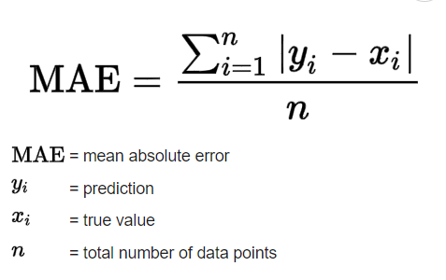
MAE: Mean Absolute Error (MAE)
A lower MAPE value indicates a more accurate prediction
A MAPE of 0% means the prediction is the same as the actual,
A higher MAPE value indicates a less accurate prediction.
Example (in forecasting)
A MAPE value of <10% indicates highly accurate forecasting,
10% ≤ MAPE <20% indicates good forecasting,
20% ≤ MAPE <50% indicates reasonable forecasting,
50% ≥ MAPE indicates inaccurate forecasting
Mean Absolute Error (MAE) is a measure of the average size of the mistakes in a collection of predictions without taking their direction into account.
USA | Singapore
©DeepSphereAI.SG 2021 | Confidential & Proprietary

Slide 6
Mean Squared Error
MSE is used to check how close estimates or forecasts are to actual values. The lower the MSE, the closer the forecast is to the actual. This is used as a model evaluation measure for regression models, and a lower value indicates a better fit.
USA | Singapore
©DeepSphereAI.SG 2021 | Confidential & Proprietary

Slide 7
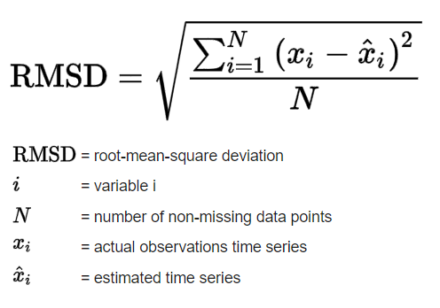
RSME (Root Mean Squared Error)
Based on a rule of thumb, it can be said that RMSE values between 0.2 and 0.5 show that the model can relatively predict the data accurately.
A value of 0 means that the predicted values perfectly match the actual values, but you’ll never see that in practice.
Low RMSE values indicate that the model fits the data well and has more precise predictions.
Higher values suggest more error and less precise predictions.
The root mean square error (RMSE) measures the average difference between model’s predicted and actual values.
USA | Singapore
©DeepSphereAI.SG 2021 | Confidential & Proprietary

Slide 8
Model Evaluation Measure: Guidelines
# | MSE / RSME | MAE | R2
1 | Based on square of error | Based on absolute value of error | Based on correlation between actual and predicted value
2 | Value lies between 0 to ∞ | Value lies between 0 to ∞ | Value lies between 0 and 1
3 | Sensitive to outliers, punishes larger error more | Treat larger and small errors equally. Not sensitive to outliers | Not sensitive to outliers
4 | Small value indicates better model | Small value indicates better model | Value near 1 indicates better model
A few things to keep in mind
RSME is always greater than or equal to MAE (RSME >= MAE).
The greater the difference between them, the greater the variance in individual errors in the sample.
USA | Singapore
©DeepSphereAI.SG 2021 | Confidential & Proprietary

